Slide 1
JavaScript Programming Basics
Chapter 1

Slide 2
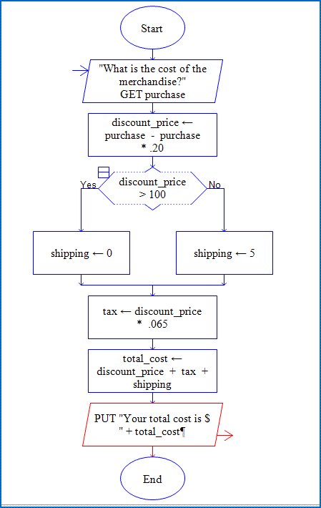
1.1
What is Programming?

Slide 3
The Program Development Cycle
Analyze the problem
What information are you given?
What information is needed to get desired results?
Design a program to solve the problem
Include step-by-step instructions
Can use flowcharts or pseudocode
Code the program
Test the program
At any time you find a flaw, revise!

Slide 4
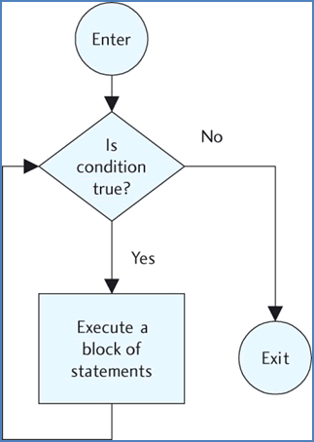
1.2
The Structure of a Program

Slide 5
Input-Processing-Output
Input:
prompts
previous values
other files
Processing:
what the program does with input and other information
Output:
display on screen
information sent to other places

Slide 6
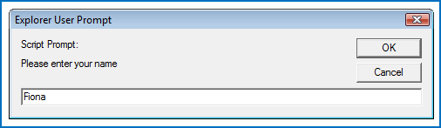
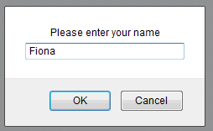
Prompts
Prompt:
var name = prompt("Please enter your name"," ");
User sees:
(Internet Explorer) (Firefox)
After entering “Fiona”, the variable name holds the value “Fiona”

Slide 7
Processing the Input
Example:
<script type="text/javascript"> var name = prompt("Please enter your name"," ");
var greeting = "Hello there, " + name + "!";
</script>
If the user enters “Fiona”, the variable name = “Fiona” and the variable greeting = “Hello there, Fiona!”

Slide 8
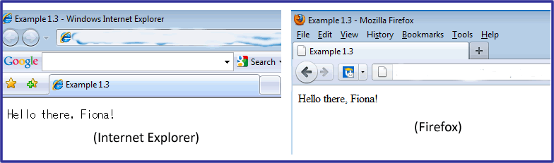
Output
Example:
<script type="text/javascript"> var name = prompt("Please enter your name"," ");
var greeting = "Hello there, " + name + "!";
document.write(greeting);
</script>

Slide 9
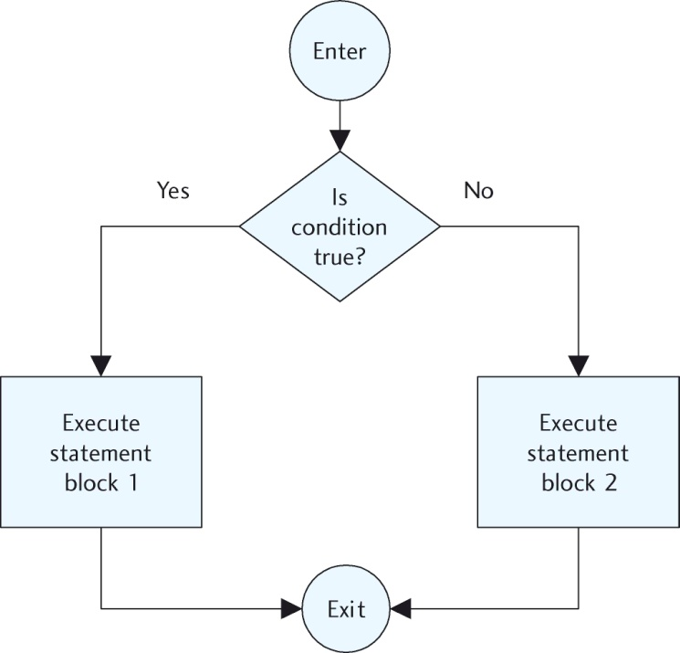
The Control Structures
The sequential (or sequence) structure
statements execute in sequence
The decision (or selection) structure
statements execute if a condition is true
if not, either nothing happens or other statements execute
The loop (or repetition) structure
statements execute until a condition is no longer true

Slide 10
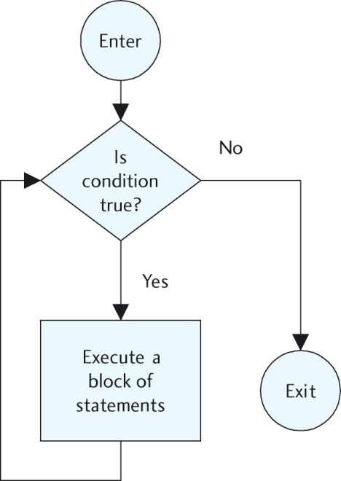
The Control Structures
The decision (or selection) structure
The loop (or repetition) structure

Slide 11

1.3
Data Types and Operations on Data

Slide 12
Numerical Data
Numbers are values that can be processed and calculated.
Many languages make a distinction between integers and floating point numbers.
JavaScript: when a number is stored in a variable, it is initially treated as a floating point number.
All numbers in JavaScript are initially stored as the numerical data type.
When a number is entered into a prompt box, it is initially stored as a text value.
It cannot be used in a calculation.
It must be turned into a numeric value to use in a calculation.

Slide 13
String Data
Strings are a series of keyboard characters enclosed in quotation marks.
Strings can consist of words, phrases, sentences, and even whole paragraphs.
A string can also be a single character such as a letter or a punctuation character.
When a number is stored as a string, it cannot be used in a numerical calculation or process.

Slide 14
Variables and Named Constants
A variable is called a variable because it can vary.
A quantity that can change value during the execution of a program.
Any time we need to refer to that data, we refer to its variable name.
A named constant is a value that is used often in a program but will not change value throughout the program, such as the number in a dozen or the tax rate charged on purchases.

Slide 15
Assignment Statements
Declaring variables: Use the var keyword
var age;
creates a variable named age
var age = 23;
creates a variable named age which is assigned an initial value of 23

Slide 16
Operations on Data
Arithmetic Operators:
Operator | Description | Example | Result, if y = 3
+ | Addition | x = y + 2 | x = 5
- | Subtraction | x = y - 2 | x = 1
* | Multiplication | x = y * 2 | x = 6
/ | Division | x = y / 2 | x = 1.5
% | Modulus | x = y % 2 | x = 1

Slide 17
The Concatenation Operator
Concatenation Operator: joins two strings together
The symbol is + but, by the context, the computer knows that it is not used to add values.
Example:
greeting = “Good morning"
name = “Robbie"
The following statement concatenates the variables and other text and stores it as one string in a third variable named welcome:
welcome = greeting + “, “ + name; After the execution of this statement, the variable welcome contains :
“Good morning, Robbie”

Slide 18

1.4
Problem Solving: The Importance of Logical Thinking

Slide 19
Pseudocode and Flowcharts
Pseudocode is a way to think through and design a program before writing the actual code.
Pseudocode uses short, English-like phrases to describe the outline of a program.
Flowcharts are diagrams that use special symbols to display pictorially the flow of execution within a program or program module.
Often programmers use both pseudocode and flowcharts at various stages of a program’s development.

Slide 20
1.5
JavaScript in the Web Page

Slide 21
The <script></script> Tag Pair The <noscript></noscript> Tag Pair
<script></script>:
Used to define a client-side script like JavaScript
<noscript></noscript>:
Used to provide alternate content for users who have disabled scripts in their browsers
Used to provide alternate content for browsers that don’t support client-side scripting – rare today
<noscript>
Sorry, your browser doesn't support JavaScript.
</noscript>

Slide 22

JavaScript in a Web Page <body>
Using inline JavaScript with a button:
Code to add a button to a web page:
<input type="button" id="myButton" value="Hi there!" onclick="alert('Well, hello my friend.');" />
Creates a button that looks like this:
When clicked, you get an alert that says:
Well, hello, my friend.

Slide 23
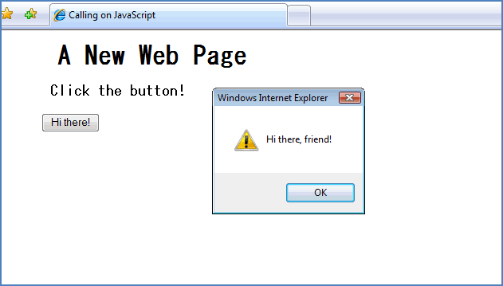
JavaScript in the Document <head> Section Most JavaScript we will write will be in <head> section JavaScript executes when user does something in web page
<html> <head> <title>Example</title> <script> function welcome() { alert("Hi there, friend!"); } </script> </<head>> <body> <h1>A New Web Page</h1> <h3>Click the button! </h3> <p><input type="button“
id="myButton" value="Hi
there!" onclick =
"welcome();" /></p>
</body> </html>

Slide 24
The <body> onload Event
Loads JavaScript before user views the page, as it is loading
<html> <head> <title>Example</title> <script> function welcome() { alert("Hi there, friend!"); } </script> </<head>> <body onload = “welcome()”> <h1>A New Web Page</h1> <h3> This site is nothing but fun!</h3>
</body> </html>

Slide 25
1.6
Introduction to Objects

Slide 26
What is an Object? Properties and Methods
Anything that has properties and a function (or functions) is an object.
Properties are qualities, traits, or attributes common to a specific thing—or object.
Properties (also called attributes) describe the object
A function, in this context, is a process or operation executed by or to the object.
Methods (also called functions) are the things the object can do or have done to it.

Slide 27
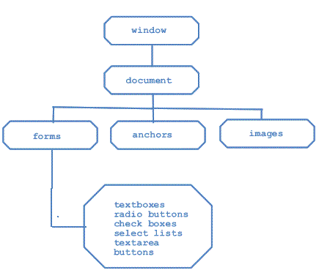
The Document Object
An HTML document is an object.
It uses the Document Object Model (DOM)

Slide 28
Dot Notation
You instruct the browser where to place content by using dot notation.
The object is accessed, then a dot, and then any further instructions (methods or attributes) are appended.
document.write("Welcome to my first JavaScript page!");
The document object is accessed. The dot says to use the write() method on the document object.

Slide 29
The getElementById() Method
Each part of a web page is called an element
To access an element use the getElementById() method
Allows access a particular container within a document
Each container must be marked with an identifier
Add an id attribute to the HTML tag

Slide 30
The innerHTML Property
The innerHTML property sets or returns the inner HTML of an element.
1. <html> 2. <head> 3. <title>Example</title> 4. <script type="text/javascript"> 5. function getValue() 6. { 7. var dog = document.getElementById("puppy"); 8. document.write("Your dog is not a terrier <br />"); 9. document.write("It is a ");
10. document.write(dog.innerHTML); 11.} 12.</script> 13.</head> 14.<body> 15. <h1 id = "puppy" onclick="getValue()">Poodle</h1> 16.</body> 17.</html>
The id of the <h1> tag is “puppy” (line 15).
Line 6 gets the value of the contents of the element with the id “puppy”.
Line 10 uses that value in the output

Slide 31
The open() and close() Methods These methods open or close a new window
The innerHTML property sets or returns the inner HTML of an element.
1. <html> 2. <head> 3. <title>Using the open() and close() Methods</title> 4. <script type="text/javascript"> 5. function openWin() 6. { 7. smallWindow = window.open("","", "width=300, height=200");
8. smallWindow.document.write("<p>Hi again, old friend!<br />Glad to see
you today</p>");
9. } 10. function closeWin() 11. { 12. smallWindow.close(); 13. } 14. </script> 15. </head> 16. <body> 17. <input type = "button" value = "Open a small window“ onclick = "openWin()" />
18. <input type = "button" value = "Close the small window“
onclick = "closeWin()" />
19. </body> 20. </html>

Slide 32
1.7
Introduction to JavaScript Functions and Events

Slide 33
JavaScript Functions
A function is used to isolate a group of instructional statements so that other parts of the program can use that code.
Functions and methods can normally be used interchangeably.
Two main categories of functions: user-created and built-in
Syntax to create your own function:
type the function keyword
Follow with the function’s name
Put all statements within opening and closing curly brackets ({ }).
function name()
{
JavaScript statements...;
}

Slide 34
Built-in Functions
Some built-in JavaScript functions that we have used so far:
alert()
write()
open()
close()
getElementById()

Slide 35
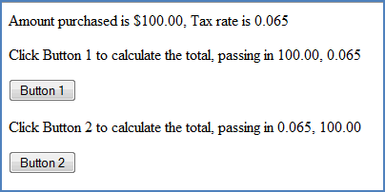


Parameters In general, parameters are values that are passed into a function.
<head> <title>Using parameters</title> <script type="text/javascript"> function calculateTotal(purchaseAmt, taxRate) { tax = purchaseAmt * taxRate;
total = purchaseAmt + tax;
document.write("Your total is $ "+total);
} </script> </head> <body>
<p>Amount purchased is $100.00, Tax rate is 0.065</p>
<p>Click Button 1 to calculate total, passing in 100.00, 0.065<p>
<input type="button" value="Button 1" onclick = "calculateTotal(100, .04)" />
<p>Click Button 2 to calculate the total, passing in 0.065, 100.00<p>
<input type="button" value="Button 1" onclick = "calculateTotal(0.065, 100)" />
</body>

Slide 36
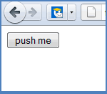
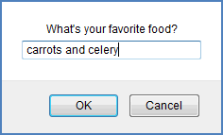
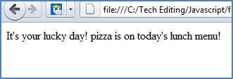

The prompt() Function Allows us to prompt the user to input values which can then be used in any way
You first see:
After pushing the button:
If user enters pizza:
If user enters cake:
<head>
<title>The prompt() Function</title> <script type="text/javascript"> function showPrompt() { var food = prompt("What's your favorite food?", "carrots and celery"); document.write("It's your lucky day! " + food +" is on today's lunch menu!");
} </script> </head> <body> <input type="button" onclick = "showPrompt()“ value = "push me" />
</body>

Slide 37
Introduction to JavaScript Events
An event is an action that can be detected by JavaScript
Usually events are used in combination with functions
When an event occurs, the function is executed
Called event-driven programming
Events:
a mouse click
a web page or image loading
rolling a mouse over a link, an image, or another hot spot on a web page
selecting an element or a field on a form

Slide 38
Using a Prompt and an Event
1. <html> 2. <head> 3. <title> JavaScript Events</title> 4. <script type="text/javascript"> 5. function greet() 6. { 7. var name = prompt("Please enter your name"," "); 8. document.write("<h2>Hello " + name + "! <br />How are you today?</h2>");
9. } 10. </script> 11. </head> 12. <body> 13. <h2 id ="hello">Who are you?</h2> 14. <button type="button" onclick="greet()">Enter your
name</button>
15. </body> 16. </html>

Slide 39
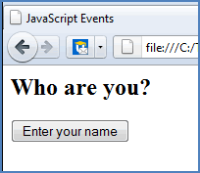
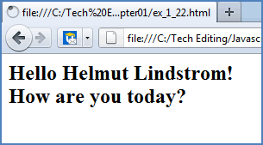
Example Output
Initially, this page has a single line
and a button and looks like this:
If the user presses the button, types in
Helmut Lindstrom at the prompt,
and presses OK, the page will now look like this:

